Slide 1
Extending Entities
October 17, 2014
Notes:
Guidewire training materials contain Guidewire proprietary information that is subject to confidentiality and non-disclosure agreements. You agree to use the information in this manual solely for the purpose of training to implement Guidewire software solutions. You also agree not to disclose the information in this manual to third parties or copy this manual without prior written consent from Guidewire. Guidewire training may be given only by Guidewire employees or certified Guidewire partners under the appropriate agreement with Guidewire.
1

Slide 2
Distinguish between platform, application, and customer entities
Edit an entity extension
Create an entity extension
Notes:
2

Slide 3
Base application entities
Entity Editor
Edit an entity extension
Create an entity extension
Notes:
3

Slide 4
Entities in applications
ClaimCenter
PolicyCenter
BillingCenter
Application entities are specific to application
Claim
Policy
Producer
Platform entities are common to all Guidewire applications
Activity
User
Guidewire Platform
Notes:
Activity and User are entities common to all Guidewire applications. Claim is specific to ClaimCenter. Quote is specific to PolicyCenter. Account, Policy, and Producer are the three key entities to BillingCenter. Entities are defined in XML files.
4

Slide 5
Entity files
ClaimCenter
PolicyCenter
BillingCenter
Entities are XML files
Entity (ETI)
Internal entity extension (EIX)
Application
ETI
EIX
Platform
ETI
Guidewire Platform
Notes:
Platform entities are always found in the …\modules\configuration\config\metadata\entity\ folder. All ETI and EIX files in the \metadata\entity\ are read-only. You cannot edit these files directly in Guidewire Studio and should not edit these files in any other application. Many platform entities have the platform="true" attribute defined in the <entity /> element. Ignore the deprecated base="true" or base="false" attribute in the <entity /> element.
Some application specific entities can also be found in the \metadata\entity\ folder. Many application entities are extendable in the sense that they can be both subtyped and/or an entity extension can be created. Entities with the final="true" attribute defined in the <entity /> element cannot be subtyped. Entities with the extendable="false" attribute defined in the <entity /> element cannot be extended in the sense that new elements cannot be added to the entity.
The EIX file contains extensions to the platform-level entities that are required for the base application and cannot be modified. EIX files are extensions to platform-layer entities created by Guidewire development to meet the needs of a given application's base data model.
5

Slide 6
Customer entity extensions
ClaimCenter
PolicyCenter
BillingCenter
Entity extension (ETX) files
Customers can create and edit ETX files
Claim.etx
Policy.etx
Producer.etx
Guidewire Platform
Notes:
Customer can create or edit entity extensions. Entity extensions are always found in the …\modules\configuration\config\extensions\entity\ folder.
6

Slide 7
Customer entities and Gosu classes
configuration
application server
ABContact
Fields ID Name
FaxPhone
WebAddress_Ext
ABContact.eti
ABContact.etx
ab_abcontact
database table row
anABContact
instance of Gosu class
read from database
save to database
Notes:
For a base application data model entity, the entity is defined by both its original ETI file and the ETX extending file, if one exists. In certain cases, there is an internal entity extension, EIX, file. Regardless of which file the field is declared in, all fields from all files become the internal Gosu class.
For fields that are added to a base application entity, Guidewire recommends that the field name should end with _Ext (or start with Ext_). In the slide example, the ABContact.etx entity extension file contains the WebAddress_Ext field.
Students coming from an Object-Oriented Programming (OOP) background should be aware that the term "extend" gets used in OOP differently than it does in Guidewire. In OOP, the term "extend" is used to refer to creating a new subclass that extends some parent superclass.
In Guidewire data model configuration, the term "extend" is sometimes used to refer to adding new fields to an existing base application entity. In this sense, no new subclass or subtype entity is getting created. One is simply adding additional fields to an existing base application entity.
7

Slide 8
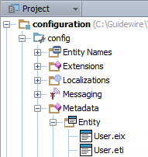
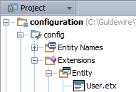
Project view entity files
…\metadata\entity\
…\extensions\entity
Read-only files
Entity (ETI)
Internal entity extension (EIX)
Editable files
Entity (ETI)
Entity extension (ETX)
Notes:
Guidewire provides certain entity extensions as part of the base application configuration. Many of the extension index definitions address performance issues. Other extensions provide the ability to configure the data model in ways that would not be possible if the extension was part of the base data model. Do not simply overwrite a Guidewire extension with your own extension without understanding the full implications of the change.
Because EIX (entity internal extension) files are neither created nor modified by configuration developers, this lesson does not discuss their structure. If you need to make multiple extensions to a single entity at different points in time, all extensions for that entity should be added to the same ETX file.
As a customer, you can create customer entities (ETI), create extension entities (ETX). You can also edit editable entity (ETI) and entity extension (ETX) files.
8

Slide 9
Base application entities
Entity Editor
Edit an entity extension
Create an entity extension
Notes:
9

Slide 10
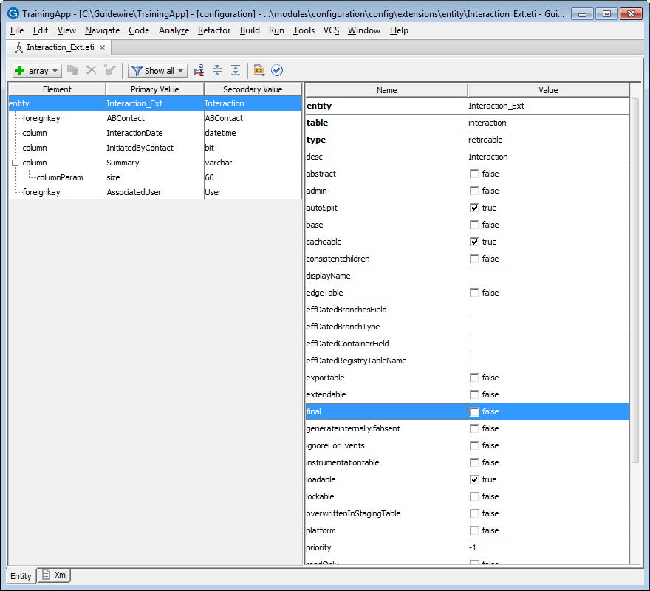
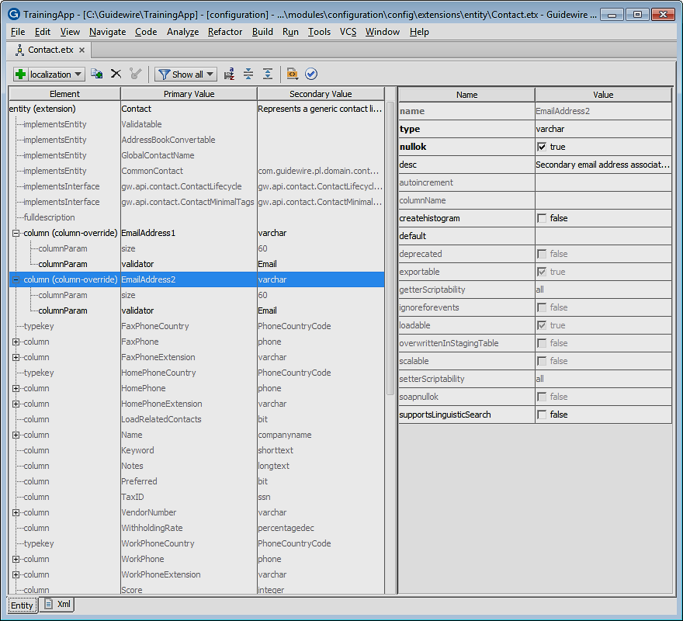
Entity editor
For entity, entity extension, or internal entity extension files
\extensions\entity\
ETI and ETX files
View, edit and create
\metadata\entity\
ETI and EIX files
View only
Editor consists of
Editor toolbar
Element tree pane
Attribute pane
View as XML
Notes:
You can define and edit an entity and entity extension located in the …\configuration\config\extensions\entity\ folder.
The Entity Editor allows you to view an entity or internal entity extension located in the \configuration\config\metadata\entity folder. Files in the \metadata\ folder are read-only.
10

Slide 11
Entity editor: Toolbar reference
 |  | Icon | Description
Actions | Edit |  | Add an element; Drop-down list is schema aware
 |  |  | Duplicate selected element
 |  |  | Delete selected element
 |  |  | Override selected element
 | View |  | Filter elements by file
 |  |  | Persist sort order
 |  |  | Collapse nested elements
 |  |  | Expand nested elements
 | Navigate |  | Navigate to supertype and/or subtype
 |  |  | Click link to navigate to extension
 | Validate |  | Validate entity
Notes:
Add, duplicate, remove, and override elements. The editor is data model / XSD aware. Editing with the editor is only available in /extensions/.
When you define and edit an entity or entity extension located in the \configuration\config\extensions\entity folder, the Entity editor toolbar is fully enabled. Entities and internal entity extensions located in the \configuration\config\metadata\entity folder are read-only and all edit actions are disabled.
Sort, filter, and collapse columns in the element tree pane. You can also easily navigate to supertype and subtype entities. Lastly, you can quickly validate your entity XML.
"Schema aware" means that Guidewire Studio only shows the allowed options for a given element or attribute.
11

Slide 12
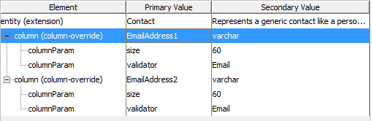
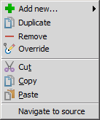
Entity editor: Element tree pane
Displays hierarchy of XML elements
Elements merged from underlying base entity are read-only
Sortable columns
Context menu is schema aware
Add new elements as siblings and children
Remove, cut, copy, and paste elements
Notes:
The Entity editor toolbar view actions influence the display of the Element tree pane. By default, the Element tree pane displays the hierarchy of nested elements, including any inherited elements from base entities. For entity extensions, the underlying base entities are entities and internal entity extensions. The editor is schema aware for elements and attributes. "Schema aware" means that Guidewire Studio only shows the allowed options for a given element or attribute.
12

Slide 13
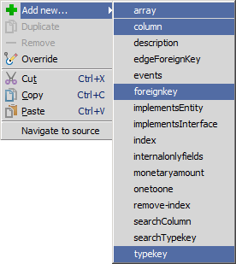
Adding elements
Toolbar
Select option in dropdown
Click + to add more of same
Context menu
Add new…
Select option in menu
Notes:
When creating elements, the Entity Editor refers to an Extensible Schema Definition (XSD) file, datamodel.xsd. The location of the file is <InstallRoot>\modules\configuration\xsd\metadata\datamodel.xsd. Not all elements define fields in a database, for example, <events />. Other elements are specific to database performance such as <index />.
The four primary elements listed above are common to entity extension (<extension>), entity declaration (<entity>), subtype extension (<extension>), and subtype declaration (<subtype>).
13

Slide 14
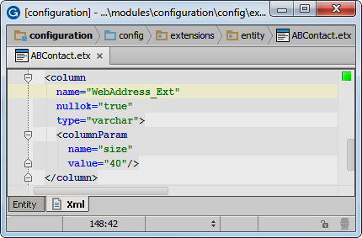
Common elements to add
Xml tab shows read-only view of elements
Common elements for entity extension, entity, subtype, subtype extension are:
<array …/>
Define array entity and field
<column …/>
Define data field with defined data type
Bit, datetime, integer, varchar
<foreignkey …/>
Define foreign key field and entity
<typekey …/>
Define typekey and related typelist
Notes:
The four primary elements listed above are common to entity extension (<extension>), entity declaration (<entity>), subtype extension (<extension>), and subtype declaration (<subtype>). You can view the XML elements by clicking on the Xml tab.
14

Slide 15
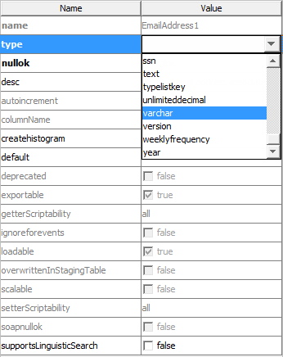
Entity editor: Attribute pane
Name Value columns
For selected element, define attributes
Schema aware values
Boolean controls
Dropdown lists
Attribute styling
Bold for required; Black for editable
Grayed-out for non-editable
Overridden, Inherited, Internal, Default
Set nullok to true in most cases
Notes:
"Schema aware" means that Guidewire Studio only shows the allowed options for a given element or attribute.
The nullok attribute is not defined with a default value. You must set a value of either true or false for the nullok attribute. In most cases, set nullok to true.
15

Slide 16
Base application entities
Entity Editor
Edit an entity extension
Create an entity extension
Notes:
16

Slide 17
Steps to edit an entity extension
Navigate to the entity extension
Add elements (and subelements) and specify attribute values
Optionally regenerate the dictionary
Deploy the extension entity
Notes:
17

Slide 18
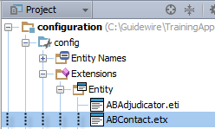
Step 1: Navigate to the entity extension
CTRL+N
Enter entity name in dialog
Verify in Project View the selection of file in …\Extensions\Entity\
Must be ETX file
Top element reads entity (extension)
XML is <extension />
Notes:
IMPORTANT: Studio will open an existing extension first, if it exists. An existing extension can be an EIX or ETX file. If the file is an EIX file, then you need to create a new entity extension. If the file is an ETI file in \Extensions\Entity\, then you can simply edit the file.
18

Slide 19
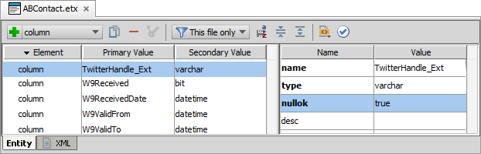
Step 2: Add elements and define attributes
Toolbar to add an element for a field, e.g., <column />
Define element attributes
Name is the name of the field; Use _Ext for field name ending
Type is the data type
Nullok has no default, so set to true in most cases
Notes:
The nullok attribute has no default value. In most cases, set nullok to true. A column on a base application entity in which nullok is false may require a default value either because rows in the table exist already, or the application does a test import into the entity during the database upgrade, or both. A column on a custom entity in which nullok is true generally does not require a default value.
The columnName attribute exists because many databases have a restriction on the size of their column names. The lower limit for this maximum is typically 30. This can be a problem when field names are longer than 30 characters, which can occur when descriptive field names are requested by the customer. With the use of the columnName attribute, a Guidewire application can accommodate both requirements. The name attribute has no maximum size, so it can be as descriptive as desired. The columnName attribute has a 30 character limit, and should be used when the name attribute is greater than 30 characters.
In the slide example, there TwitterHandle_Ext column does not exist in TrainingApp.
19

Slide 20
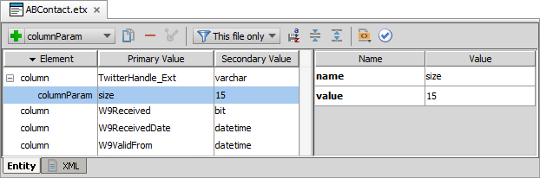
Add subelements
Use the toolbar to add a columnParam
Some elements require subelements based on the element and attribute definition and in many cases the subelments are optional
Add columnParam child element to a column of type varchar to specify size, e.g., varchar(15)
Notes:
You use the <columnParam> element to set parameters that a column type requires. The type attribute of a column determines which parameters you can set or modify by using the <columnParam> subelement.
You can determine the list of parameters that a column type supports by looking up the type definition in its .dti file. You can find the datatypes dti files in the datatypes folder in …\modules\configuration\config\datatypes\. For example, the varchar.dti files defines the possible parameters for the varchar column type.
The Entity Editor is schema aware and displays the available options for you when you select the type.
In the slide example, there TwitterHandle_Ext column does not exist in TrainingApp.
20

Slide 21
Column and columnParam
Strings
Decimal numbers
Columns used to store Strings
Declare type as varchar
Requires column parameter
Size defines length of the string in characters
Columns used to store numbers with decimal values
Declare type as decimal
Requires two column parameters
Precision is the total length of decimal
Scale is the number of digits right of the decimal point
Notes:
The decimal data type works with non-integer numeric values (in other words, decimal values). The precision denotes the total number of digits of the entire value. The scale denotes the number of digits after the decimal point. For example, a decimal with precision 6 and scale 2 could include values from -9999.99 to 9999.99 (6 digits in total with two digits appearing after the decimal point).
21

Slide 22
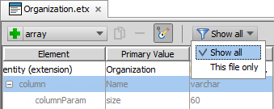
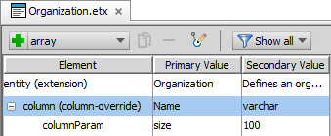
Attribute overrides
Select Show all to list all elements
Select greyed out element
Click Override
"override" shows in element
Change attribute values including subelement attributes
3
1
2
4
Notes:
In certain cases, there is no existing entity extension (ETX) file for a given entity, but you want to override the attribute of an element or subelement that exists in the internal entity extension or in the entity found in the metadata directory. In these cases, you need to first create an entity extension file. Then, in the entity extension file, you can (1) select "Show all" elements, (2) select the element in question, (3) click Override, and (4) make your changes.
Only certain elements attributes can be overridden using the override element:
<array-override> and the triggersValidation attribute
<column-override> and the createhistogram, default, nullok, size, supportsLinguisticSearch, and type attributes
<foreignkey-override> and the nullok and triggersValidation attributes
<onetoone-override> and the triggersValidation attribute
<typekey-override> and the default and nullok attributes
22

Slide 23
Step 3: Optionally regenerate dictionary
gwXX regen-dictionary
Process builds entire entity model including base and custom entities
Identifies errors in the data model beyond Entity Editor schema validation
C:\Guidewire\TrainingApp\bin>gwta regen-dictionary regen-entity-model-xml: ==================================================== = Running main class: com.guidewire.tools.dictionary.data.EntityModelXmlTool [java] --- Guidewire Entity Model In Xml --- … ERROR Errors found in ABContact ERROR Attribute 'value' in element 'columnParam' is required. ERROR ColumnIsValid - The column "WebAddress_Ext" on entity "ABContact" declares an invalid data type, "varchar". null
Notes:
You can also optionally regenerate the data dictionary to add the new entity to the data dictionary and to check for problems in the data model. Regenerating the data dictionary is not required, but doing so can identify flawed XML in the data model that go beyond schema validation such as certain types of referential integrity.
23

Slide 24
Step 4: Deploy the entity extension
Restart Server
bin command window
gwXX dev-stop
gwXX dev-start
Or, Guidewire Studio
Run → Stop
Run 'Server' or Debug 'Server'
During start-up
If autoupgrade=true in database-config.xml, then Guidewire attempts to upgrade the database according to the changes in the data model
Entity Extension
Entity Extension
Notes:
24

Slide 25
Lesson outline
Base application entities
Entity Editor
Edit an entity extension
Create an entity extension
Notes:
25

Slide 26
Steps to create an entity extension
Navigate to the entity
Create an entity extension file
Add elements (and subelements) and specify attribute values
Optionally regenerate the dictionary
Deploy the extension entity
Notes:
26

Slide 27
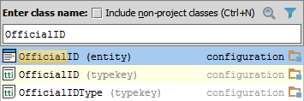
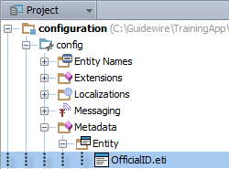
Step 1: Navigate to the entity
CTRL+N
Enter entity name in dialog
Verify in Project View the selection of file in …\Metadata\Entity\
Most cases is an ETI file
In certain cases, maybe an EIX file
Notes:
IMPORTANT: When using CTRL+N, Studio will open an existing entity extension first, if it exists. An existing extension can be an EIX or ETX file. If the file is an ETX file, then do NOT create a new extension, but instead, simply edit the existing entity extension.
27

Slide 28
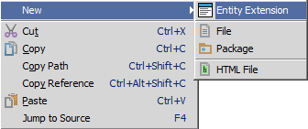
Step 2: Create an entity extension file (1)
Project View → Context menu → New → Entity Extension
Notes:
28

Slide 29
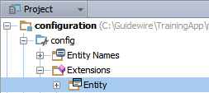
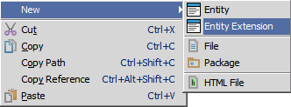
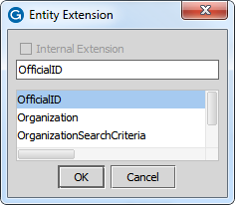
Step 1 and 2 alternative
Select …\Extensions\Entity\
Context menu → New → Entity Extension
In dialog, enter entity name
Notes:
29

Slide 30

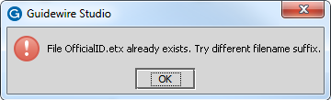
Step 2: Create an entity extension file (2)
For an entity (ETI) in …\Extensions\Entity\
NOT possible to create entity extension (ETX)
Edit the ETI file directly in the Entity Editor
For an entity extension (ETX) in …\Extensions\Entity
NOT possible to create entity extension (ETX)
Edit the ETX file directly in the Entity Editor
Notes:
The default Guidewire Studio settings do not allow for you to create an entity extension of an already existing entity extension.
30

Slide 31
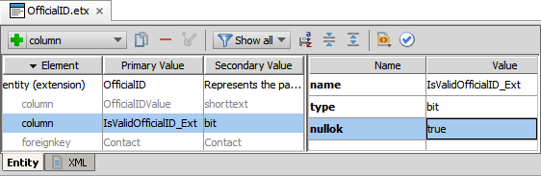
Step 3: Add elements and define attributes
Toolbar to add an element for a field, e.g., <column />
Define element attributes
Name is the name of the field
Use _Ext for field name ending
Type is the data type
Nullok has no default value; set to true in most cases
Notes:
31

Slide 32
Step 4: Optionally regenerate dictionary
gwXX regen-dictionary
Process builds entire entity model including base and custom entities
Identifies errors in the data model beyond Entity Editor schema validation
C:\Guidewire\TrainingApp\bin>gwta regen-dictionary regen-entity-model-xml: ==================================================== = Running main class: com.guidewire.tools.dictionary.data.EntityModelXmlTool [java] --- Guidewire Entity Model In Xml --- … ERROR Errors found in OfficalID ERROR NoTwoColumnsWithTheSameName property "IsValidOfficialID_Ext" found for entity "OfficialID"
Notes:
You can also optionally regenerate the data dictionary to add the new entity to the data dictionary and to check for problems in the data model. Regenerating the data dictionary is not required, but doing so can identify flawed XML in the data model that go beyond schema validation such as certain types of referential integrity.
32

Slide 33
Step 5: Deploy the entity extension
Restart Server
bin command window
gwXX dev-stop
gwXX dev-start
Or, Guidewire Studio
Run → Stop
Run 'Server' or Debug 'Server'
During start-up
If autoupgrade=true in database-config.xml, then Guidewire attempts to upgrade the database according to the changes in the data model
Entity Extension
Entity Extension
Notes:
33

Slide 34
Distinguish between platform, application, and customer entities
Edit an entity extension
Create an entity extension
Notes:
34

Slide 35
How many ETX files can a given entity have?
What is the primary element of an ETX file?
What datatype do you enter for fields that will store….
String values?
Boolean values?
Numbers with decimal values?
Which datatypes require columnParam subelements?
Under what circumstances would you want to regenerate the Data Dictionary?
When does a Guidewire application actually modify the physical structure of the database?
Notes:
Answers
1) One ETX file per entity in most cases.
2) The primary element is <extension>
3a) varchar
3b) bit
3c) decimal
4) varchar requires size and decimal which requires precision and scale
5) You would want to regenerate the Data Dictionary whenever you extend the data model and are concerned with data model validation beyond schema validation in the Entity Editor. Regenerating the Data Dictionary also updates the dictionary files to include the new fields (or entities) that you have created.
6) The physical structure of the database is modified only during start-up.
35

Slide 36
Notes:
36

